Slide 1
Texture Packing
Group13
诸葛均豪 肖策方 周承扬

Slide 2

1、Introduction of the Project
Texture packing is important in a variety of applications. It widely existd in carriage loading, container loading and pallet loading of logistics transportation, as well as in material cutting, finished product packaging and facility layout planning of factories and enterprises. In game applications, Texture packing helps us optimize our graphics and increase the number of frames.
In simple terms, this project is to pack several rectangles into a large figure, and ask to find the minimum height of the packed figure in the case of a given width.
Requirements：
1. The width of the graph is certain, to find the minimum height.
2. The rectangle can not be rotated 90° when packing.
3. The edges of the rectangle are either parallel or perpendicular to the edges of the resulting shape.
Notes:
纹理填料在各种应用中都很重要。它广泛存在于物流运输的车厢装载、集装箱装载和托盘装载，以及工厂和企业的材料切割、成品包装和设施布局规划中。在游戏应用程序中，纹理包装帮助我们优化我们的图形和增加帧的数量。
简单地说，这个项目是将几个矩形打包成一个大图形，并要求在给定宽度的情况下找到被打包图形的最小高度。
1.结果图形宽度一定，求最小高度。
2.长方形在打包时不可以进行90°旋转。
3.长方形的边与结果图形的边是要么平行，要么垂直的。

Slide 3
2、Introduction of the Algorithm
FFDH, NFDH, BFDH Algorithm
BL Algorithm
RF Algorithm

Slide 4
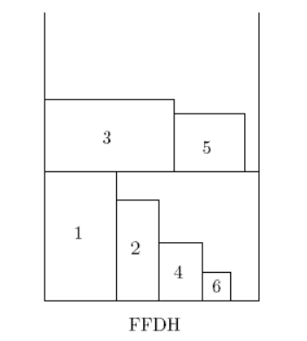
First-Fit Decreasing Heigh Algorithm
long long FFDH(int width, Rect[] rect_list) { /* First-Fit Decreasing Height */
if (IsEmpty(rect_list)) return 0;
SortByHeight(rect_list);
int[] width_taken_list; /* the used width of every exist level */
long long int current_height := 0;
for (rect in rect_list ) {
for (point = AllW.begin() to AllW.end()) {
if (rect.width > width) return -1;
if (level in levels) {
Update Width_taken of this level; /* renew the uesd width */
break;}}
if (cannot store in any exist levels) {
current_height := current_height + rect.height;
Create new level and Update width_taken of the new level;}
}
return current_height;
}
FFDH packs the next item R (in non-increasing height) on the first level where R fits;
If no level can accommodate R, a new level is created.
Approximation Ratio:
Notes:
FFDH将下一个放入的物品R(以不增加高度的顺序)包装在能够适合R的第一层；
如果没有合适的层级可以容纳R，就会创建一个新层级。

Slide 5
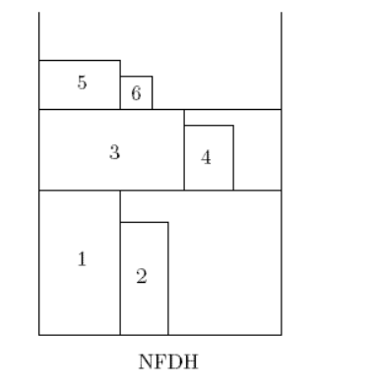
Next-Fit Decreasing Heigh Algorithm
int NFDH(int width, Rect[] rect_list) {
if (IsEmpty(rect_list)) return 0;
SortByHeight(rect_list);
int remaining_width := width;
int current_height := rect_list[0].height;
for (rect in rect_list) {
if (rect.width > width) return -1;
if (remaining_width >= rect.width) {
remaining_width := remaining_width - rect.width; }
else {
remaining_width := width - rect.with;
current_height := current_height + rect.height; }
}
return current_height;
}
NFDH packs the next item R (in non-increasing height) on the current level if R fits;
Otherwise, the current level is "closed" and a new level is created.
Approximation Ratio:
Notes:
如果R适合，NFDH将当前层上的下一个物品R(高度不增加)打包;
否则，当前关卡将“关闭”，并创建一个新关卡。

Slide 6

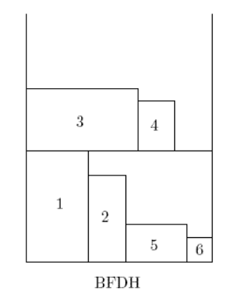
Best-Fit Decreasing Heigh Algorithm
int BFDH(int width, Rect[] rect_list) {
if (IsEmpty(rect_list)) return 0;
SortByHeight(rect_list);
int current_height := 0;
for (rect in rect_list) {
if (rect.width > width) return -1;
Find Min remaining_width no less than rect.width;
if (found) {
min_remaining_width := remaining_width - rect.width; }
else {
height := height + rect.height;
remaining_width := width - rect.width;
add remaining_width to remaining_width_list; }
}
return current_height;
}
BFDH packs the next item R (in non-increasing height) on the level, among those that can accommodate R, for which the residual horizontal space is the minimum;
If no level can accommodate R, a new level is created.
Approximation Ratio:
Notes:
FFDH将下一个放入的物品R(以不增加高度的顺序)包装在能够适合R的第一层；
如果没有合适的层级可以容纳R，就会创建一个新层级。

Slide 7

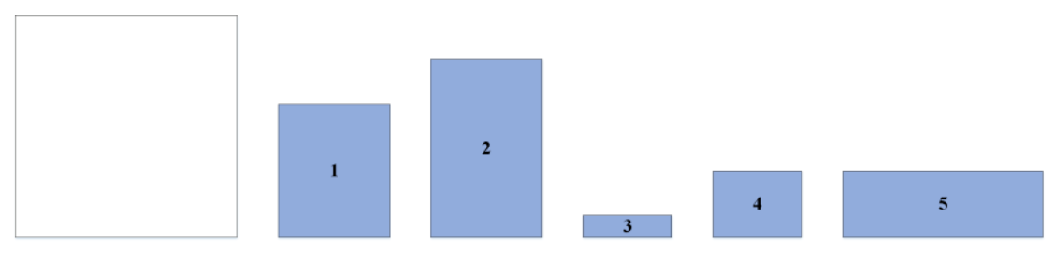
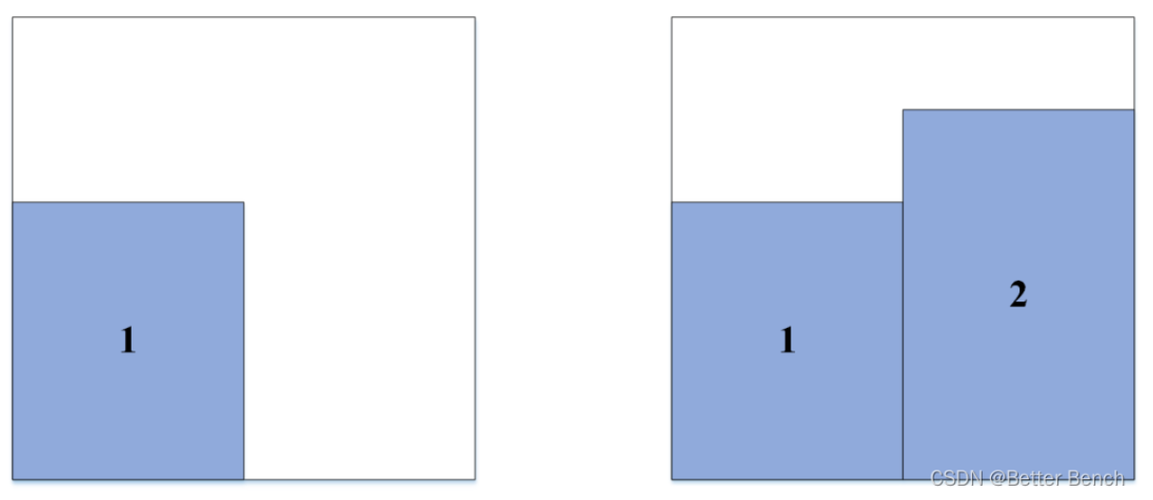
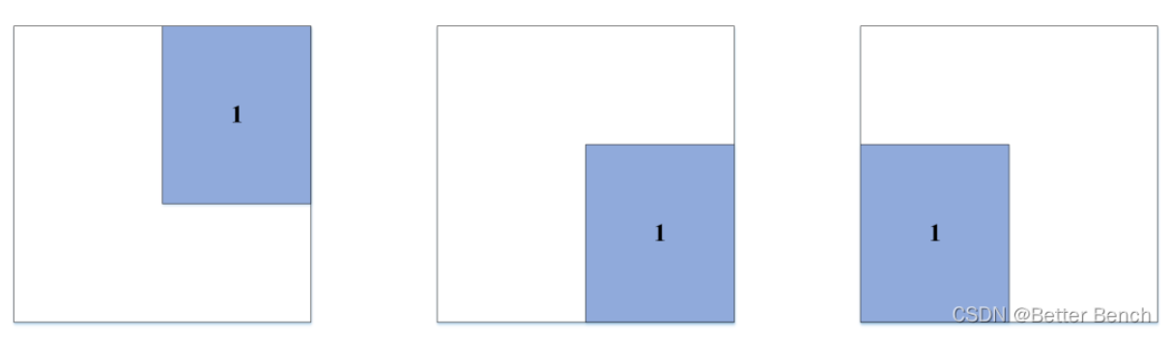
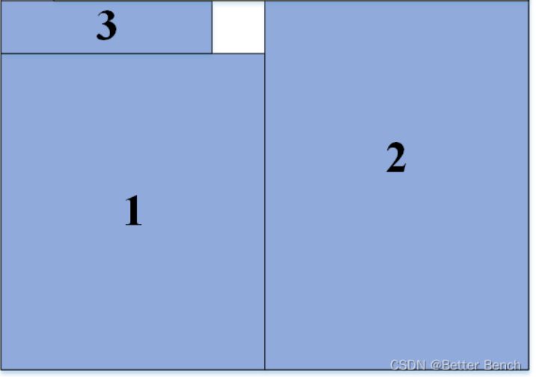
Bottom-Left Algorithm
BL first order items by non-increasing width. BL packs the next item as near to the bottom as it will fit and then as close to the left as it can go without overlapping with any packed item;
Note that BL is not a level-oriented packing algorithm.
Approximation Ratio:
int BL(int width, Rect[] rect_list)
{
if (IsEmpty(rect_list)) return 0;
SortByWidth(rect_list);
for (rect in rect_list){
if (rect.width > width) return -1;
Place rect at rightmost and top most;
Move rect down until rects already in pack block it;
Move rect left until rects already in pack block it;
Move rect down until rects already in pack block it;
}
}
Notes:
BL首先将物件按照宽度不递增的瞬息排列。将下一个项目尽可能靠近底部，然后尽可能靠近左边，而不与任何打包的项目重叠;
注意BL不是一个面向级别的封装算法。

Slide 8
Bottom-Left Algorithm
/* More detailed implementation */
int BL(int width, Rect[] rect_list)
{
if (IsEmpty(rect_list)) return 0;
SortByWidth(rect_list);
for (rect in rect_list){
if (rect.width > width) return -1;
Place rect at right most;
y0 := 0;
for (texture in y_desc_sorted_pack) {
if (Block(rect, texture)) {
y0 := texture.y + texture.height;
break;
}
}
Move rect to (right, y0);
x := 0;
for (texture in x_desc_sorted_pack) {
if (Block(rect, texture)) {
x := texture.x +texture.width; }
}
Move rect to (x, y0);
y1 := 0;
for (texture in y_desc_sorted_pack) {
if (Block(rect, texture)) {
y1 := texture.y + texture.height;
break; }
}
Move rect to (x, y1);
}
}
Notes:
BL首先将物件按照宽度不递增的瞬息排列。将下一个项目尽可能靠近底部，然后尽可能靠近左边，而不与任何打包的项目重叠;
注意BL不是一个面向级别的封装算法。

Slide 9
Reverse-fit Algorithm
RF is an algorithm ignited by the algorithms above. We can find that when we pack rects leveloriented, the rightmost and topmost of one level is often empty, which causes a lot of spacewasting.
RF first stacks all items of width greater than 1/2. Remaining items are sorted in non-increasing height and will be packed above the height H0 reached by those greater than 1/2. Then RF repeats the following process.
Roughly speaking, RF packs items from left to right with their bottom along the line of height H0 until there is no more room. Then packs items from right to left, piling them on first level directly(called second-level) until the total width is at least 1/2. Repeat this by establishing a new first level on the highest rect in second level.
Note that there is a famous RF implemented by someone, but our version is a little different from it.
Approximation Ratio: The approximation ratio of the well-known RF algorithm is 2.
Notes:
BL首先将物件按照宽度不递增的瞬息排列。将下一个项目尽可能靠近底部，然后尽可能靠近左边，而不与任何打包的项目重叠;
注意BL不是一个面向级别的封装算法。

Slide 10
Reverse-fit Algorithm
long long RF(int width, Rect[] rect_list) {
Rect[] rest_rect_list;
Point[] first_level_list;
long long current_height := 0;
if (IsEmpty(rect_list)) return 0;
for (rect in rect_list) {
if (rect.width > width) return -1;
if (rect.width > width / 2)
/* Stack rect that is wider than half at the bottom */ {
current_height := current_height + rect.height;
}
else
/* Copy rect that has not been stacked */ {
Add rect to rest_rect_list; }
}
int i := 0;
while (exist rect in rest_rect_list has not been packed) {
Pack rects from left to right on current_height; /* First Level */
Drop rects from top to bottom until it hit rects in first level or ground on current_height
from right to left until rects has taken up at least half of the width. /* Second Level */
}
}
Notes:
BL首先将物件按照宽度不递增的瞬息排列。将下一个项目尽可能靠近底部，然后尽可能靠近左边，而不与任何打包的项目重叠;
注意BL不是一个面向级别的封装算法。

Slide 11
3、Analysis for the Complexity
Time Complexity:
FFDH: the worst case is every rectangle need to create a new level, the time complexity is 1+2+3+...+N=O(N²);
NFDH: this algorithm only has to traverse all the rect in order, which is O(N), while it takes time to
sort them before traverse, which is O(NlogN). So the time complexity is O(NlogN);
BFDH: for every time inserting the rectangle, we need to check each level whenever it can store this rectangle or not, thus the time complexity is 1+2+3+...+N=O(N²);
BL: the worst case is that the inserted rectangle never be blocked and can move down forever, the time complexity is (1+2+3+...+N)/2=O(N²);
RF: this algorithm traverse rects and for each rect in second level, it checks collision with first
level. The number of rect in the first level is relevant to width and rects, and for the worst case, it is O(N). So the time complexity is O(N*N)=O(N²).
Space Complexity:
store all the rectangles need 2N=O(N), and for each algorithm, it will create new vector , each size won't exceed N, and the number of the vector is constant. So all the space complexity of each algorithm is O(N)

Slide 12
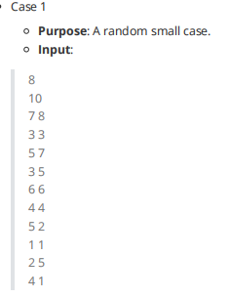
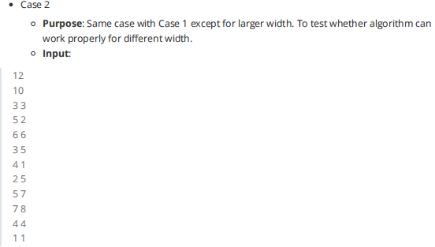
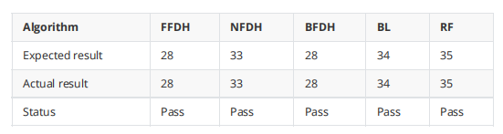
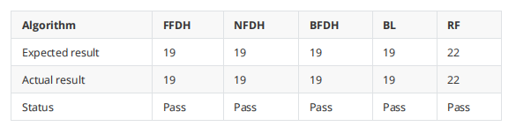
4、Result
Correctness Testing:
Notes:
从整合后的高度来看， 当给定大长方形宽度较大时，整体高度没有太多区别。当宽度较小时，NFDH的综合整合效果较差， 其次是BL。BFDH和FFDH的效果较为接近， BFDH略优一点

Slide 13
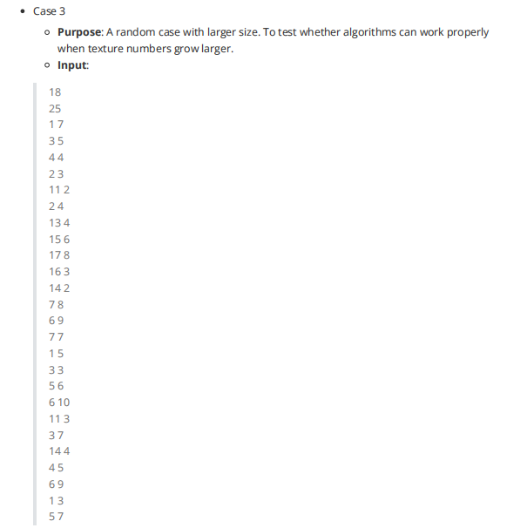

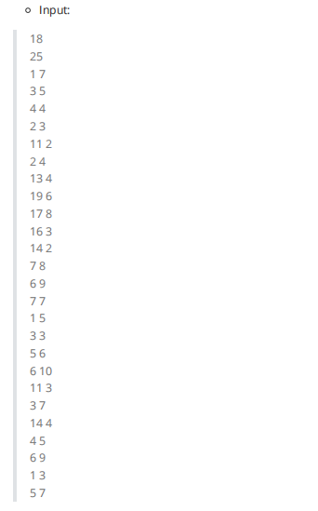
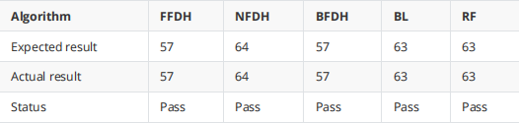
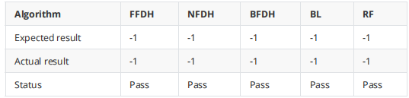
Notes:
从整合后的高度来看， 当给定大长方形宽度较大时，整体高度没有太多区别。当宽度较小时，NFDH的综合整合效果较差， 其次是BL。BFDH和FFDH的效果较为接近， BFDH略优一点

Slide 14
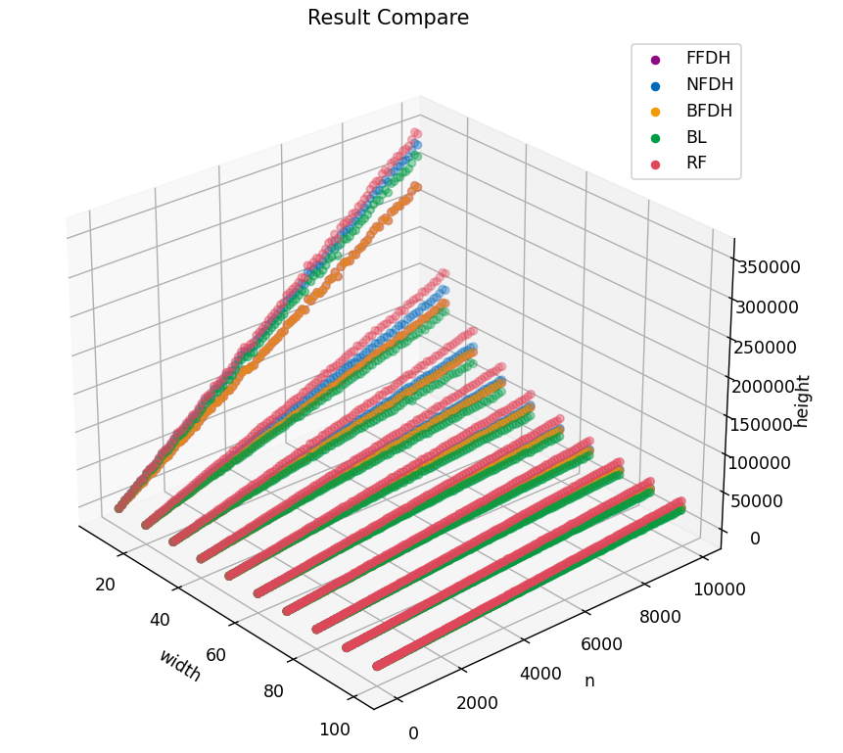
4、Result
Height Comparison:
According to the graph, we can find BFDH and FFDH work good when the width is small.
But when the big rectangle’s width grows bigger, BL works better.
Note that you can not find FFDH(Purple) in the graph because it is almost the same as BFDH(Yellow) and thus been covered.
Notes:
从整合后的高度来看， 当给定大长方形宽度较大时，整体高度没有太多区别。当宽度较小时，NFDH的综合整合效果较差， 其次是BL。BFDH和FFDH的效果较为接近， BFDH略优一点

Slide 15
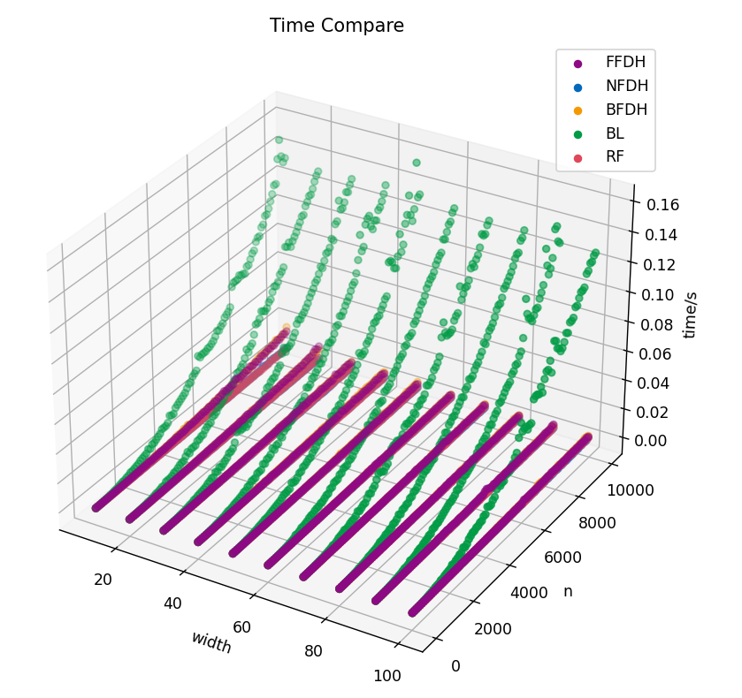
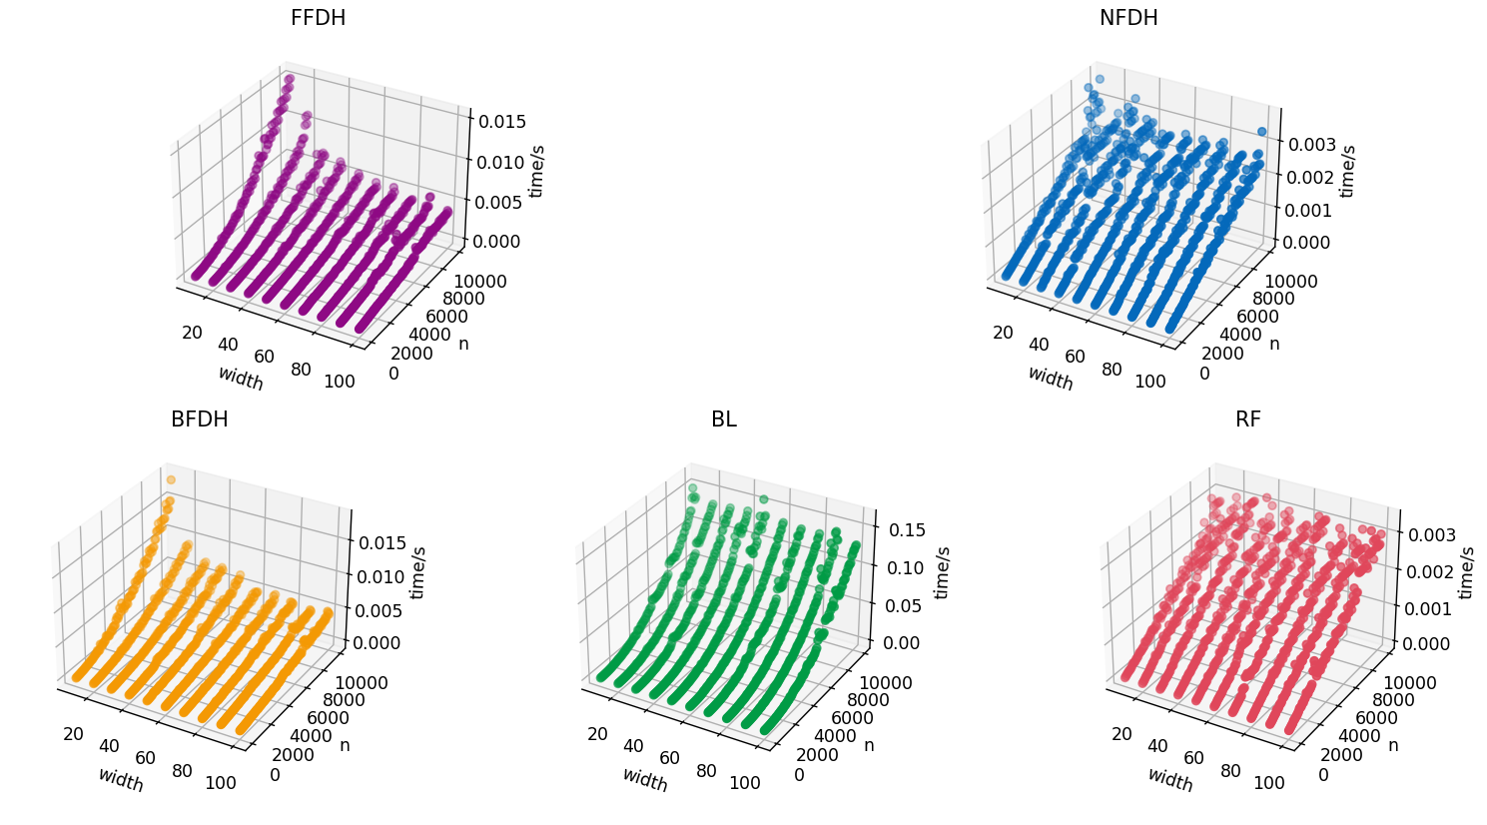
4、Result
Time Comparison:
Though the time complexity of BL is just the same as FFDH and BFDH, its actual performance when dealing with the random data generated by our program is quite poor.
And because it is far slower than other algorithms, the comparison among the other algorithms is not revealed by this graph
Notes:
与时间复杂度分析一致，NFDH的运行耗时最短。BFDH和FFDH基本耗时一样。而BL算法因为其每一步操作数较多，时间消耗最大

Slide 16
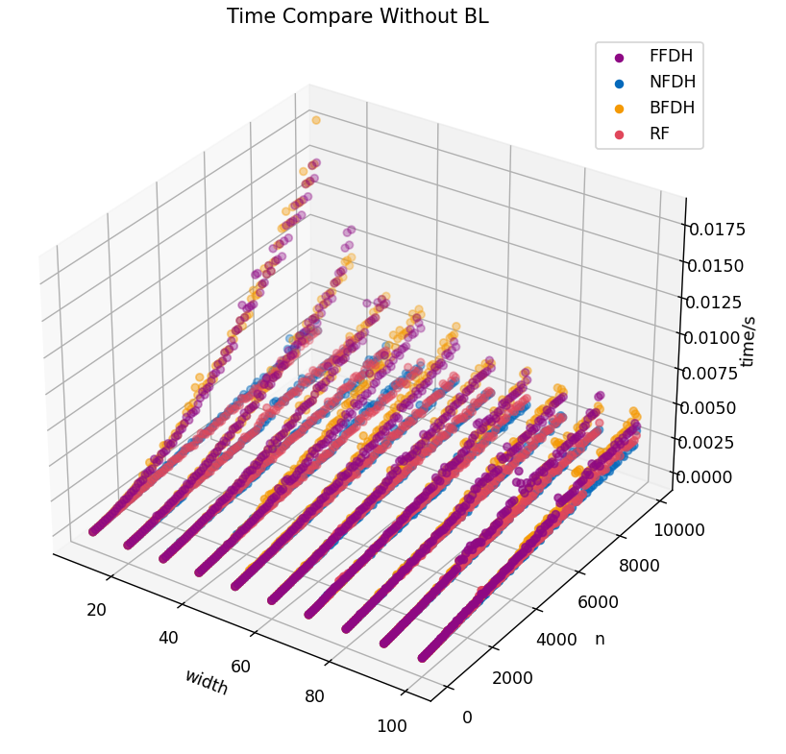
4、Result
Time Comparison:
we can find that the performance of FFDH and BFDH is very close and when the width of the strip is larger, both of them perform better while width seemed to matter little to other algorithms.
Also, it can be further confirmed by the graph that our algorithm FFDH and BFDHO(N²) is much slower than NFDH O(NlogN)
Notes:
与时间复杂度分析一致，NFDH的运行耗时最短。BFDH和FFDH基本耗时一样。而BL算法因为其每一步操作数较多，时间消耗最大

Slide 17
Thank you for listening 2022/5/19

